Slide 1
Polar Transformation

Slide 2
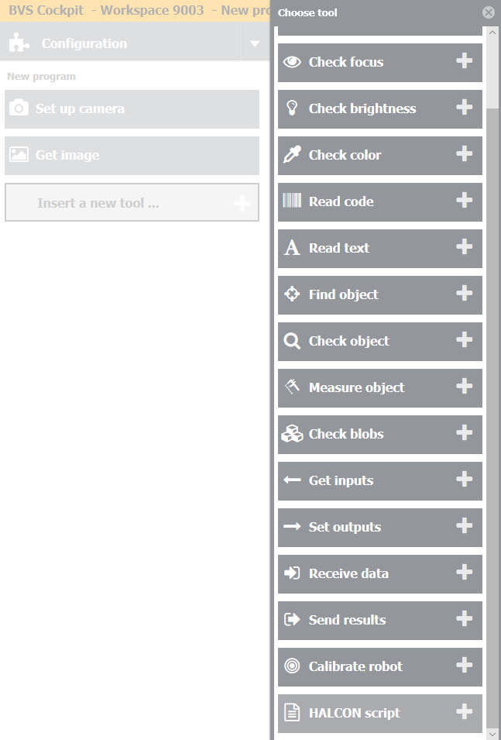
Step 1
Add new tool – Halcon Script – in your inspection program.

Slide 3
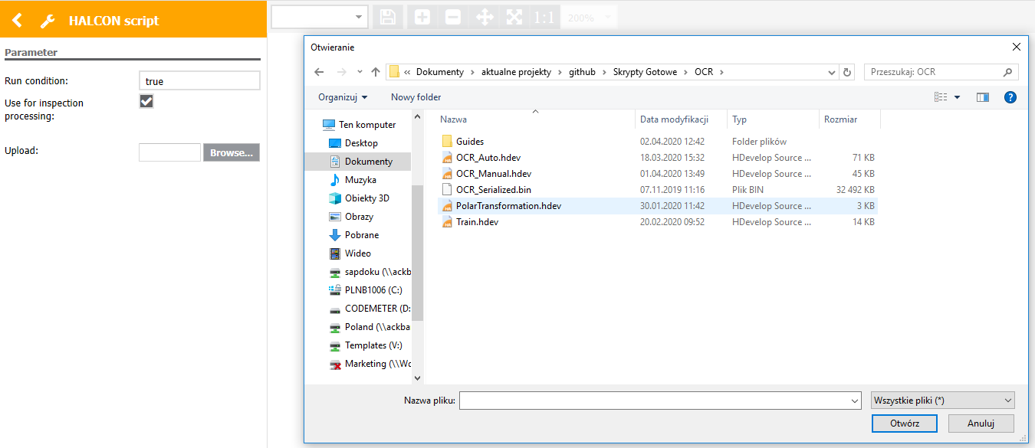
Step 2
Click „Browse” and choose „EdgeCounterArcPairs.hdev” file.

Slide 4
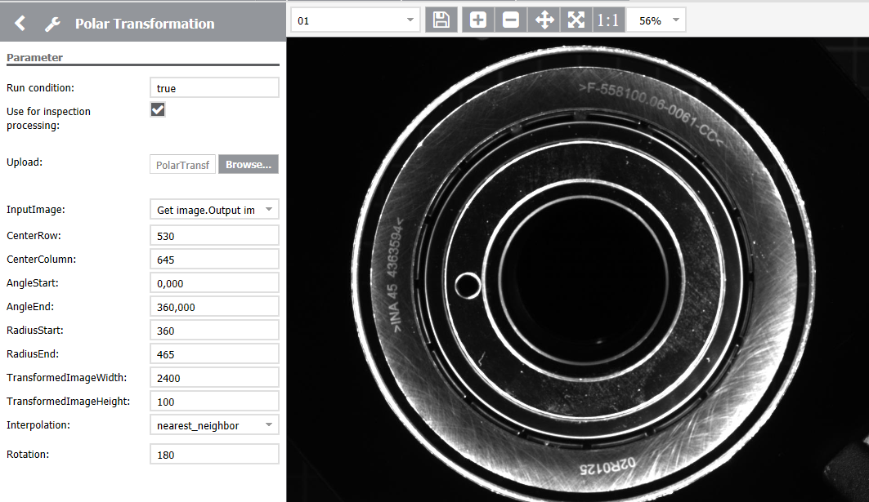
Step 3
Set the parameters:
CenterRow – center Y position of the circular element
CenterColumn – center X position of the circular element
AngleStart and AngleEnd – between that angle range the circular element will be transformed
RadiusStart and RadiusEnd – between that radius range circular element will be transformed
TransformedImageWidth – width of the output image
TransformedImageHeight – height of the output image
Interpolation – interpolation method
Rotation – angle of image rotation after transformation

Slide 5
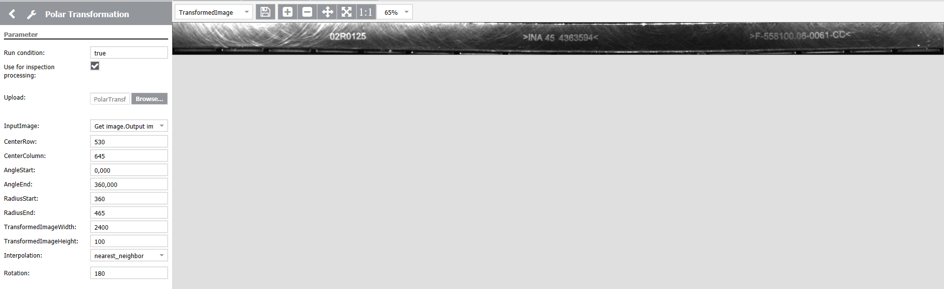
Step 4
Transformed Image can be used for example for OCR reading.

